Slide 1

BOTASTRA presents
Pitch-a-bot
Name: Archisman Roy
Admn no. : 21JE0152
Problem Statement No. : 1B

Slide 2
Problem Statement
In present-day India, Traffic jams are a major problem especially during the peak hours of work during the weekdays in major cities. On any intersection there are moments when the density of traffic on one or more lanes is light and the other lanes have a high density. A normal traffic signaling system is incapable of doing anything to optimize this condition, the result of this is traffic jams, fuel wastage and pollution. To counter this problem, with the use of sensors,you have to come up with an idea to reduce the traffic and maintain free flow of traffic especially during the peak hours. You should also try to make your solution as economical as possible.

Slide 3
Understanding the problems
01
Pre-defined set of timings , set for each traffic signal despite the density circumstances.
02
As a result of this , traffic jams are common during the peak hours in any major city.
Negative effects of traffic congestion include :
Wastage of time
Wastage of fuel increasing air pollution
Wear and tear on vehicles as a result of idling in traffic and frequent acceleration and braking and many more .

Slide 4
Idea And Approach
The proposed system contains the solution to these problems.
The idea is to make use of sensors at the traffic intersection to determine the density of vehicles in each lane. The vehicles in the lane having highest density are allowed to move first.
For this we have changed the signal timings.
The working would be as follows :
In a traffic junction of four lanes the density is measured on each lane through the ultrasonic sensors. The lane with the highest density of vehicles is determined and that lane’s signal is turned on to “green”. Meanwhile the “red” signal time for the other lanes are increased so as to clear the traffic first.
Once this clearance is finished , the traffic flow in all the lanes run normally till the sensor again detects high traffic density in any one of the four lanes.

Slide 5
Components Required
1. Arduino Mega 2560
2. 4 X HC-SR04 ultrasonic sensors
3. 4 X Red LEDs
4. 4 X Green LEDs
5. 4 X Yellow LEDs
6. 12 X 220 ohm resistors
7. Jumper cables
8. Breadboards

Slide 6
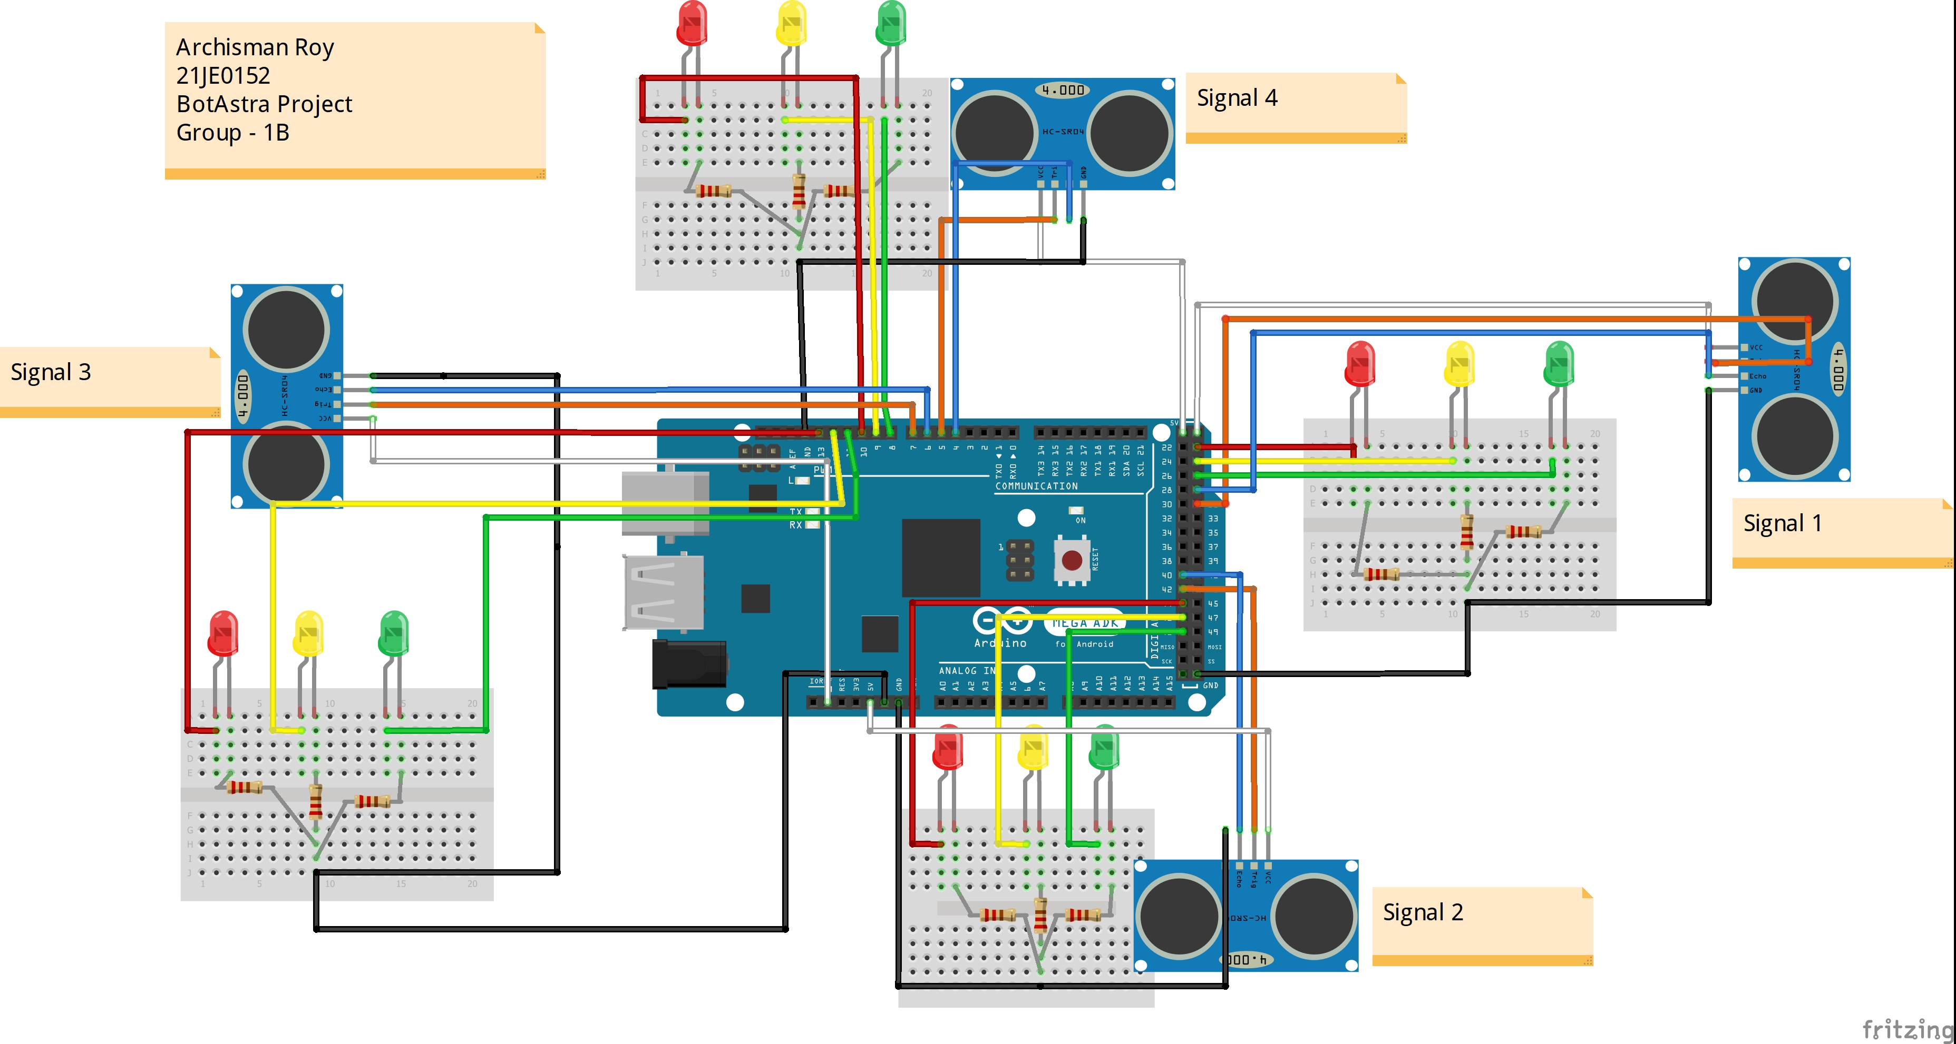
CONNECTION AND CIRCUIT DIAGRAM

Slide 7
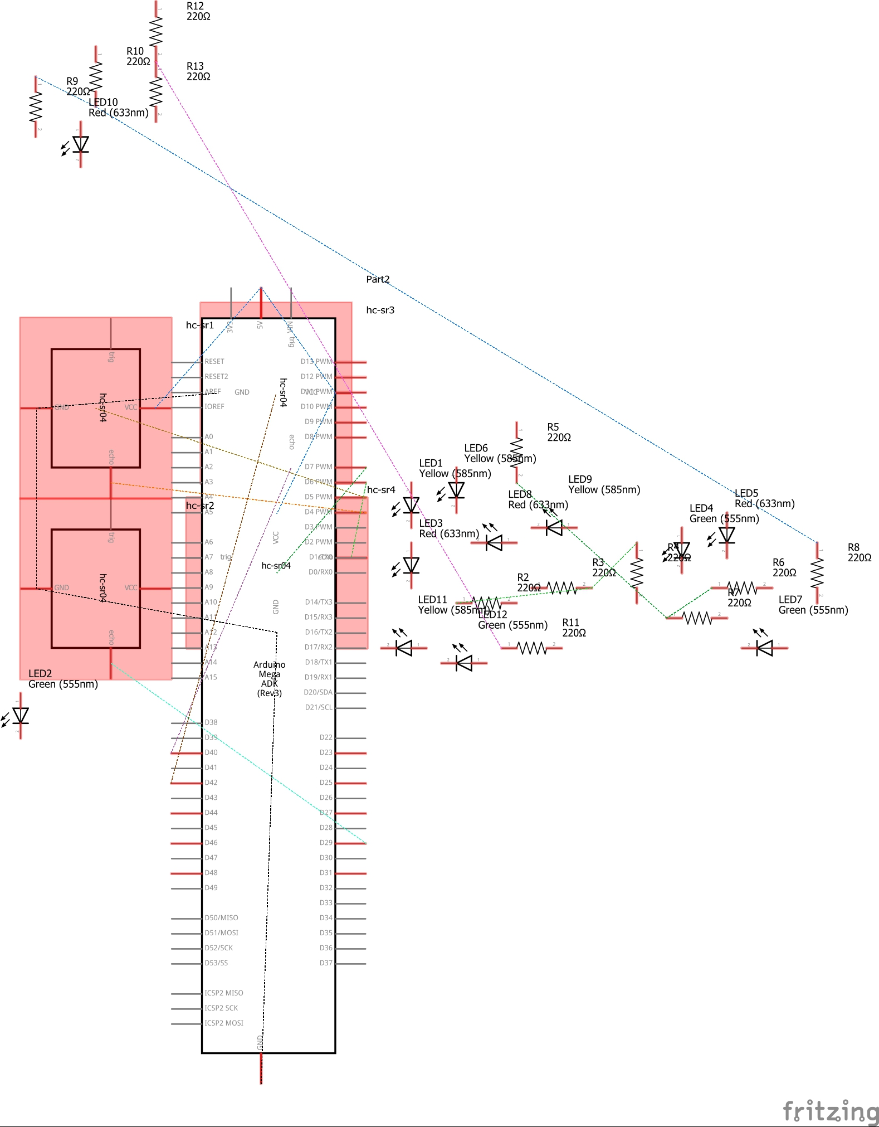
CONNECTION AND CIRCUIT DIAGRAM

Slide 8
PSEUDOCODE
We include the Math library
#include <math.h>
2. We make 4 signal functions namely signal1Function() , signal2Function () , signal3Function() and
signal4Function()
Each of these signal functions performs three operations when called :
Call the function low()
Make RED LED LOW
Make Green HIGH for 5 seconds (using delay() )
3. We make a function low() which is called when any of the above signal function is called .
Its function is to make all LED's LOW except RED one's.

Slide 9
PSEUDOCODE
4 . Read from the 4 sensors using the softInterr() function and store the density values in variables
d1 , d2 , d3 , d4 for each signal and print them using :
Serial.print(" S1: ");
Serial.print(d1);
5. Determine the highest value among d1,d2,d3,d4 and call the corresponding signal function.
For example if d2 is highest then signal2Function() is called first followed by the second highest
value and so on .
Once the desired signal function is executed , the loop() function is called . It is done to receive the sensor readings once again and to repeat step 5 .
The main purpose of this step is to ensure that traffic densities are checked regularly so that
traffic does not increase in any lane while the loop is being executed.

Slide 10
TAKEAWAY AND RESOURCES
First of all I would like to thank my Seniors for giving me this opportunity to make this exciting project. There are a lot of takeaways from this project. I have learned how exactly the traffic signals work not only in India but also in foreign countries like the US and the Netherlands. I have also gained knowledge about the various sensors and their functions .
I have also learned programming in Arduino and some of its basic functions .
One of the problems I faced during the making of this project was making the circuit diagram as I have never worked with Fritzing before. I had to go through a lot of resources available on the internet to finally be able to design it.
The next problem I faced was the logic part of the code . In this project I used a four lane intersection with 4 different signals. Initially my idea was to selectively assign “Red” signal to each of the lanes for the more efficient flow of traffic but there were a lot of (if-else) conditions to be imposed making the program lengthy .
However , this will be one of the developments I want to make in this project in the future,

Slide 11
Prospect
Sensors :
1. Active IR sensors would replace Ultrasonic sensors as it provide count, presence, speed,
and occupancy data in both night and day operation. The laser diode type can also be used for
vehicle classification because it provides vehicle profile and shape data.
2. Video Image Processors(VIP) : A video image processor (VIP) is a combination of hardware and
software which extracts desired information from data provided by an imaging sensor. This
imaging sensor can be a conventional TV camera or an infrared camera. A VIP can detect speed,
occupancy, count, and presence.
AI/ML :
1. This project can be extended to a larger scale by interconnecting successive traffic signal data
and using Machine Learning algorithms to predict the timing of the successive signals. These
data could be handled in a control room which provides traffic scenarios throughout the city.
Emergency situations : This project can be extended to detect emergency vehicles (police , ambulance) and allow these signals to be turned “Green” .

Slide 12
RESOURCES
https://www.civil.iitb.ac.in/tvm/nptel/576_VAS/web/web.html#x1-60002.3
https://www.electronicshub.org/density-based-traffic-signal-system-using-microcontroller/
https://github.com/mahadi18/Density-Based-Traffic-Light-Control-System
https://wokwi.com/arduino/libraries/demo/blink
https://www.youtube.com/watch?v=nbs97LQanHc
https://www.youtube.com/watch?v=-saXw1EipX0

Slide 13

Thank you!

